Slide 1
Milestone 2
Group 4 - Chatbot

Slide 2
WHAT IS DONE
Chatbot:
Book-Search
Filter by page number
Filter by category
Filter by author
Modular structure
Admin :
Dashboard
Comment/Rating View
API

Slide 3
HOW DO WE CONTROL THE FLOW OF CONVERSATION?
Modulating the Code

Slide 4
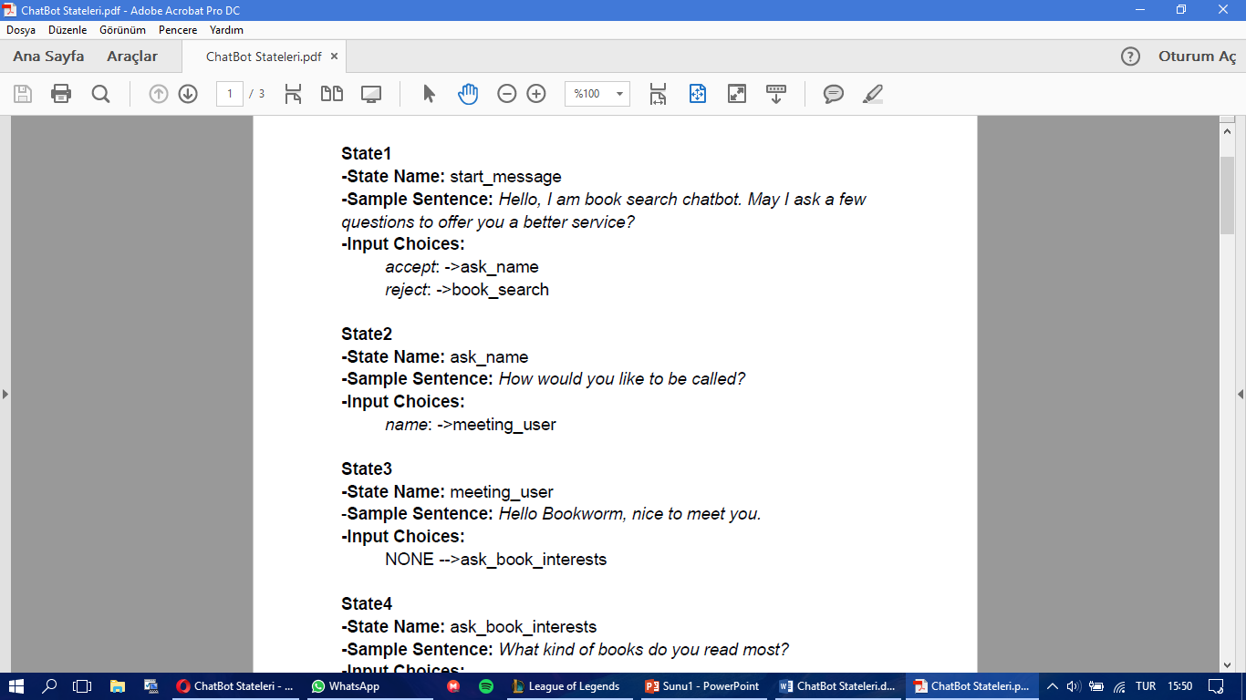
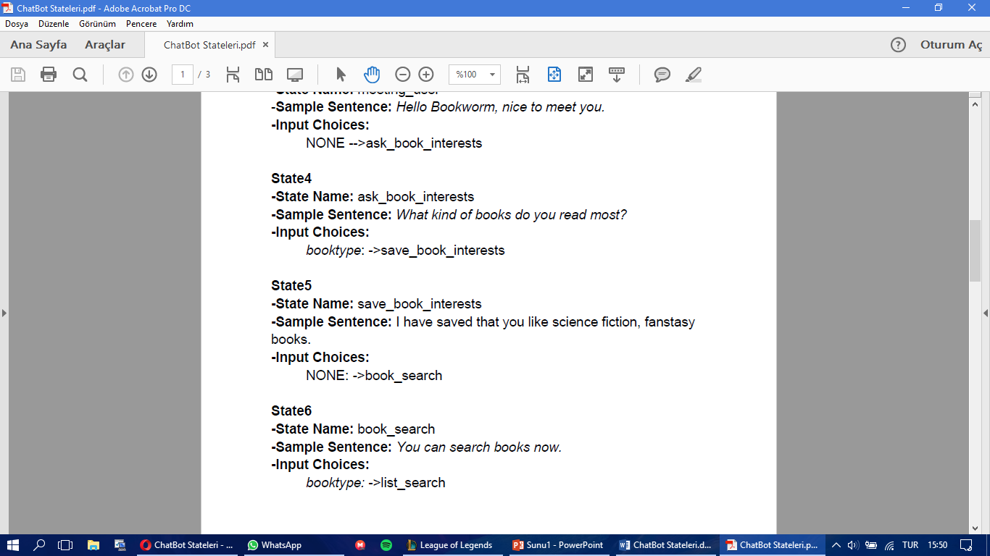
State Definition
Edit state
Intents from Wit.ai
Change flow

Slide 5
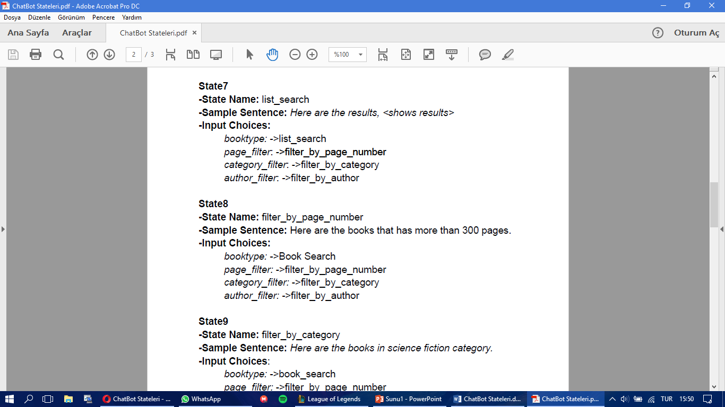
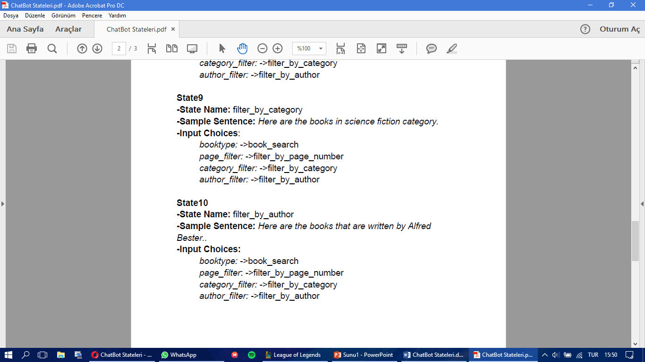

Slide 6
ADMIN WEB PAGE

Slide 7
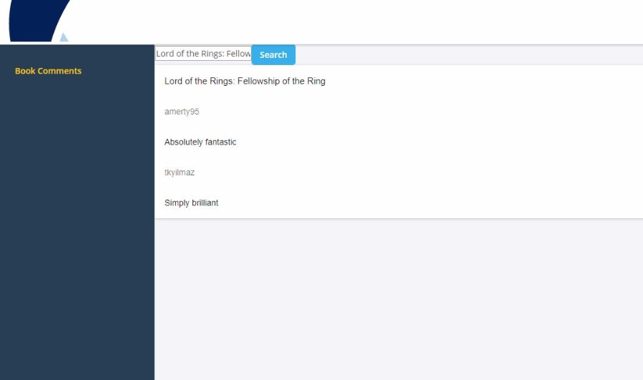
Book Comments

Slide 8
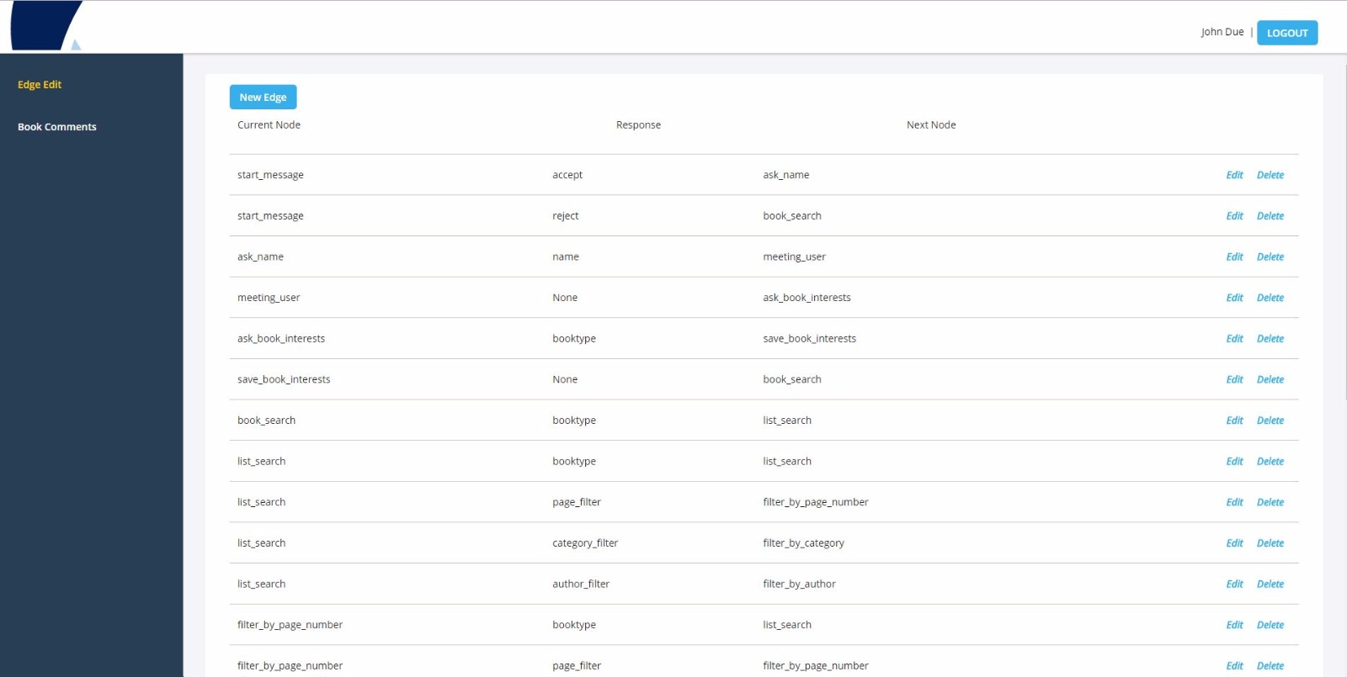
Edge List

Slide 9
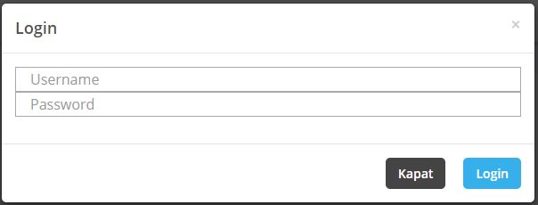
Log In Page

Slide 10
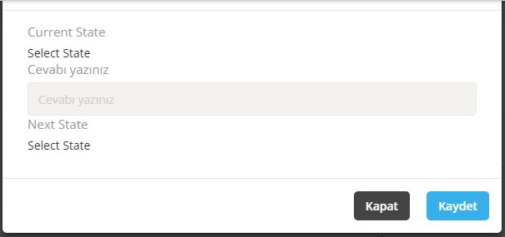
Edge Edit

Slide 11
DEMO

Slide 12
DIFFICULTIES
Modulating the code
Fitting previous work to modular structure
API requests and responses
Our communicator lost his voice ☹

Slide 13
WHAT IS NEXT
Chatbot:
Comment and rate books
View details of a book
View these comments and ratings by generic user
Book recommendation
Admin:
Edit Conversation Graph from Admin Web page

Slide 14
THAT’S IT FOR NOW
THANKS FOR LISTENING

